Slide 1
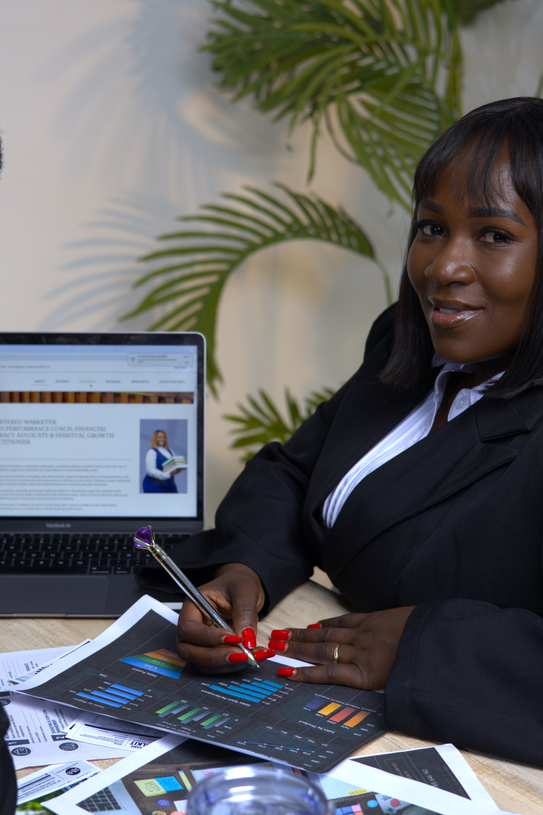

A PRACTICAL EXECUTIVE SELF-AUDIT
The Executive Digital Influence Scorecard
From Digital Presence to Global Influence
For executives, entrepreneurs and thought leaders who want to build visibility, credibility and commercial influence.
Notes:
Open by naming the premise: your digital presence is already speaking to the market. This scorecard measures what it is saying.

Slide 2
Before a prospective client calls you, a conference organiser invites you, a journalist contacts you, or a strategic partner agrees to meet you, there is a strong possibility they will search for you online.
Your digital presence is already speaking. What is it saying about you?
The question is no longer simply “Are you online?” The better questions are:
Are you visible? Are you credible? Are you positioned for the opportunities you want?
Use this scorecard to assess whether your current digital presence is helping you build influence—or simply creating online activity.
Notes:
Before a client calls, an organiser invites or a partner meets you, they search. Shift the question from presence to positioning.

Slide 3
HOW TO SCORE
Six dimensions. Thirty statements. One hundred and fifty points.
1
2
3
4
5
Significant gap
Needs improvement
Developing
Strong
Excellent
01
Digital Discoverability
02
Executive Positioning
03
Thought Leadership & Content
04
Credibility & Digital Trust
05
Global Influence Readiness
06
Digital-to-Opportunity Conversion
Notes:
Explain the mechanic: 30 statements, six dimensions, 25 points each, 150 total.

Slide 4
01
1
2
3
4
5
I can easily be found when my name is searched online.
Digital Discoverability
Search results accurately represent my professional expertise.
1
2
3
4
5
Can the right people find you?
1
2
3
4
5
My key professional profiles are current and consistent.
My digital footprint clearly connects me to my areas of expertise.
1
2
3
4
5
My online presence supports the markets and audiences I want to reach.
1
2
3
4
5
SECTION SCORE
EXECUTIVE QUESTION
If someone searched your name today, would they immediately understand who you are, what you know and why you matter?
___ / 25
Notes:
Discoverability: what the market finds when it searches your name.

Slide 5
02
I have a clear executive or thought-leadership positioning statement.
1
2
3
4
5
Executive Positioning
My biography communicates expertise, credibility and impact.
1
2
3
4
5
Does your digital presence establish authority?
My qualifications and experience are strategically presented.
1
2
3
4
5
My online profiles communicate a consistent professional identity.
1
2
3
4
5
I am clearly differentiated from others operating in my field.
1
2
3
4
5
SECTION SCORE
EXECUTIVE QUESTION
Are you simply describing what you do, or are you communicating why your expertise deserves attention?
___ / 25
Notes:
Positioning: authority, not activity.

Slide 6
03
1
2
3
4
5
I consistently share insights within my area of expertise.
Thought Leadership & Content
My content demonstrates knowledge rather than simply promoting services.
1
2
3
4
5
1
2
3
4
5
I have clearly defined thought-leadership themes.
Are you known for something?
My content speaks to the problems and opportunities facing my audience.
1
2
3
4
5
1
2
3
4
5
My digital content strengthens my professional reputation.
SECTION SCORE
EXECUTIVE QUESTION
If someone consumed your last ten pieces of content, could they clearly identify the three subjects you want to be known for?
___ / 25
Notes:
Thought leadership: three themes you want to own.

Slide 7
04
My professional achievements are appropriately visible online.
1
2
3
4
5
Credibility & Digital Trust
Testimonials, recommendations or endorsements support my credibility.
1
2
3
4
5
Does your online presence give people reasons to believe you?
Speaking engagements and professional contributions are documented.
1
2
3
4
5
1
2
3
4
5
My online profiles look professional and current.
There is strong evidence of the value and impact of my work.
1
2
3
4
5
SECTION SCORE
EXECUTIVE QUESTION
You may know that you are credible. Can someone who has never met you verify that credibility online?
___ / 25
Notes:
Credibility: evidence a stranger can verify.

Slide 8
05
My positioning can be understood by audiences outside my home market.
1
2
3
4
5
Global Influence Readiness
My content addresses issues relevant beyond my immediate network.
1
2
3
4
5
Can your expertise travel beyond your immediate network?
I intentionally build relationships with regional and global networks.
1
2
3
4
5
My digital presence supports speaking, media and partnership opportunities.
1
2
3
4
5
I have a strategy for expanding my influence beyond my current market.
1
2
3
4
5
EXECUTIVE QUESTION
If the right opportunity emerged in another African market—or globally—would your digital footprint support your credibility before you entered the room?
SECTION SCORE
___ / 25
Notes:
Global readiness: does your positioning travel?

Slide 9
06
My digital presence generates relevant enquiries or introductions.
1
2
3
4
5
Digital-to-Opportunity Conversion
1
2
3
4
5
I have clear calls to action across my key digital platforms.
1
2
3
4
5
My audience knows how to engage, book or work with me.
Is visibility translating into opportunity?
I intentionally convert digital relationships into professional opportunities.
1
2
3
4
5
I track meaningful digital outcomes beyond followers and likes.
1
2
3
4
5
SECTION SCORE
___ / 25
Notes:
Conversion: visibility that produces enquiries, introductions and work.

Slide 10
120–150
STRONG DIGITAL INFLUENCE FOUNDATION
You have built significant digital assets. Your next opportunity is to strengthen scale, strategic visibility and regional/global positioning.
90–119
VISIBLE, BUT NOT YET FULLY LEVERAGED
CALCULATE YOUR DIGITAL INFLUENCE SCORE
You have a credible foundation, but gaps may exist between visibility, authority and commercial opportunity.
Add your six section scores.
___
60–89
DIGITAL PRESENCE WITHOUT STRATEGIC POSITIONING
/150
You are online, but your digital footprint may not yet communicate the full value of your expertise.
Below 60
DIGITAL REPOSITIONING OPPORTUNITY
A structured review of your positioning, platforms, content, credibility signals and digital strategy could significantly strengthen how the market perceives you.
Notes:
Add the six section scores. Read the band, then position the audit as the way to close the gap.

Slide 11
The 5Vs of Executive Digital Influence™
The AFRILEAD framework for what a high-impact digital presence should achieve.
V
V
V
V
V
VISIBILITY
VALUE
VOICE
VALIDATION
VELOCITY
Can the right people find you?
Does your content demonstrate useful expertise?
Is there a clear perspective associated with your name?
Can people see evidence that supports your credibility?
Is your digital presence creating momentum toward bigger opportunities?
Your objective is not simply to become more visible. It is to become visible to the right people, for the right reasons, in the right markets.
Notes:
The 5Vs are the memory device. Visibility, Value, Voice, Validation, Velocity.

Slide 12
Your 30-day digital executive action plan
Choose one priority under each area.
WEEK 1
WEEK 2
WEEK 3
WEEK 4
Audit
Position
Build authority
Expand
Search your name. Review your profiles, website, images, biography and current positioning.
Clarify what you want to be known for, who needs to know you and the opportunities you want your visibility to create.
Develop three core thought-leadership themes and begin publishing valuable insights around them.
Identify ten strategic people, communities, publications, platforms or organisations that could extend your professional influence.
Notes:
One priority per week. Audit, position, build authority, expand.

Slide 13
FROM VISIBILITY TO GLOBAL INFLUENCE
Visibility
gets you noticed.
Digital transformation for an executive is not about posting every day. It is about intentionally building a digital reputation that can create trust before the meeting, credibility before the introduction and opportunity beyond your existing network.
Credibility
gets you considered.
Influence
gets you invited.
Your digital footprint should become an asset.
Strategy
turns attention into opportunity.
Notes:
Digital transformation for an executive is not about posting every day. It is about reputation that works before you enter the room.

Slide 14
READY TO DISCOVER WHAT YOUR DIGITAL PRESENCE IS REALLY SAYING?
NEXT STEP
Book an AFRILEAD Executive Digital Audit
Global Influence Executive Program
A structured pathway for building a credible executive brand and expanding professional influence across markets.
Move beyond assumptions. The audit evaluates your digital footprint and gives you practical recommendations on what to strengthen, reposition, remove, build and amplify.
—
Position your expertise.
—
Build digital authority.
Discoverability
Executive Positioning
Platform Optimisation
—
Strengthen your thought leadership.
—
Expand your strategic network.
Thought Leadership
Content
Credibility
Audience Alignment
—
Convert visibility into opportunity.
Global Influence Readiness
Opportunity Conversion
From Visibility to Credibility—Then Comes Revenue.
Racheal Musiima Senyondo
BOOK YOUR DIGITAL AUDIT
Strategy | Growth | Impact
Chartered Marketer | FCIM | FISP | MBA | Certified Financial Literacy Trainer
CEO, AFRILEAD · Empowering Africa’s Thought Leaders
Notes:
Close with the audit and the program as the next step. Invite them to book.

